Slide 1
Individual Meeting
Jason Chang

Slide 2
Outline
TSMC
Starting next week
GoEdge.ai
-
Own Paper
TimeDRL (accepted by ICDE 2024)
LLM4TS (submitted to TIST 2024)
Future Papers
PromptTSS (target: ICDM 2024)
TimeDRL-semi (target: TKDD or TNNLS)

Slide 3
Before we start
TSMC合作
去美國前的合作
Demand forecasting (競爭者分析)
並非只是暑期實習，暫定實習到出國前 (2025/02)
去美國後的合作
與在台灣的合作是否有直接關聯? (同樣的部門嗎?)
UCLA交換
目前已經取得兩邊老師的同意以及正式的文件
千里馬申請
目前只剩下計畫書，預計PromptTSS完成後再撰寫
ICDM的deadline是6/14，如果來不及submit出去還是會開始撰寫計畫書，因為千里馬的deadline是7/31
沒有申請到還是可以出國嗎? (我認為應該是，就只是沒有獎學金而已)

Slide 4
Current Schedule
目前~2024/06：PromptTSS
2024/06~2025/02：TSMC intern (1 conference paper) + Journal paper for TimeDRL
2025/02~2026/02：UCLA + TSMC collaboration in US
Fall + Winter + Spring
2026/03：口試+畢業
2026/04：TSMC US (綠卡) or other companies

Slide 5
TSMC

Slide 6
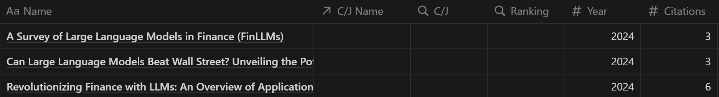
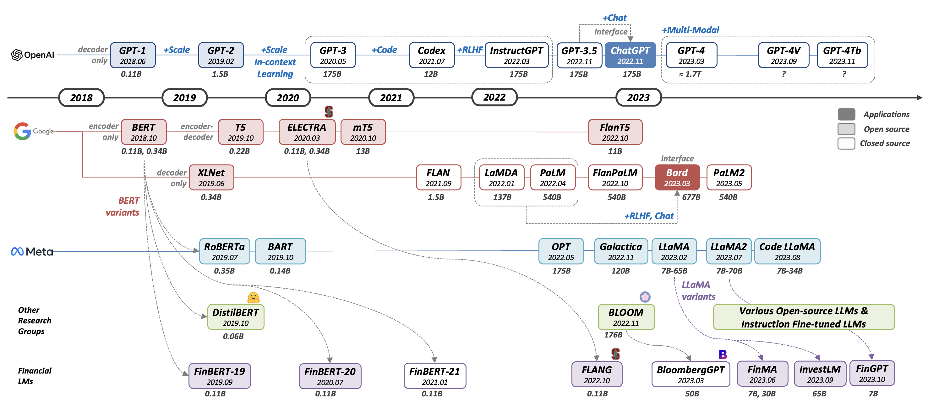
Paper List

Slide 7
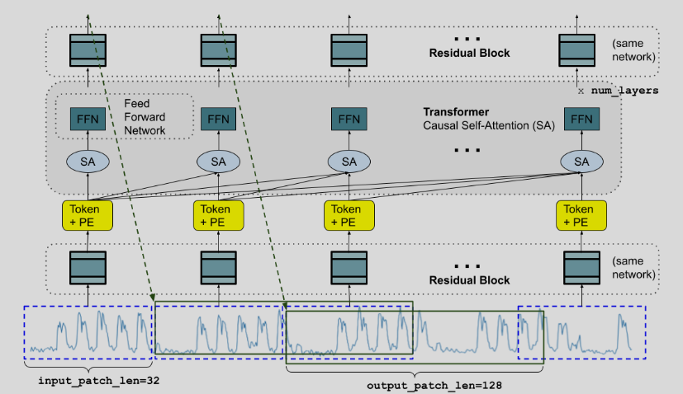
TimesFM (from Google, ICML 2024)
TimesFM is a forecasting model, pre-trained on a large time-series corpus of 100 billion real world time-points, that displays impressive zero-shot performance on a variety of public benchmarks from different domains and granularities.

Slide 8
GoEdge.ai

Slide 9
Own Paper

Slide 10
Publication Lists (First Author)
TimeDRL (ICDE 2024 accepted)
LLM4TS (TIST 2024 submitted)
PromptTSS (target: ICDM 2024)
TimeDRL-semi (only 25% difference)
Q1 journal (after ICDE acceptance)
TIST, TNNLS, TKDD, TPAMI
After the third paper
TSMC paper
UCLA paper

Slide 11
PromptTSS
Ching Chang

Slide 12
Why promptable?
Leverage more information in the inference stage
Mult-level granularity

Slide 13
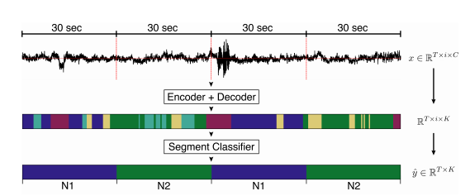
Multiple Granularity of Time-Series Segmentation
Prompt:
Class
Point
Level 1
Level 2
Level 2
Promptable
Design
Level 2
Requirements:
When training, we can leverage multi-granularity labels
When inference, we can give no prompts
Level 1
input
output

Slide 14
Experiments
Datasets
Evaluation Metrics
Baselines

Slide 15
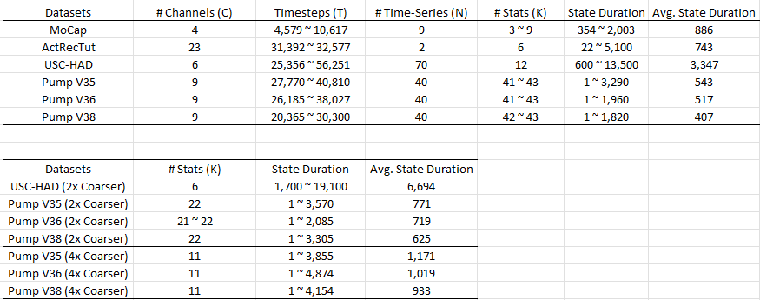
Datasets

Slide 16
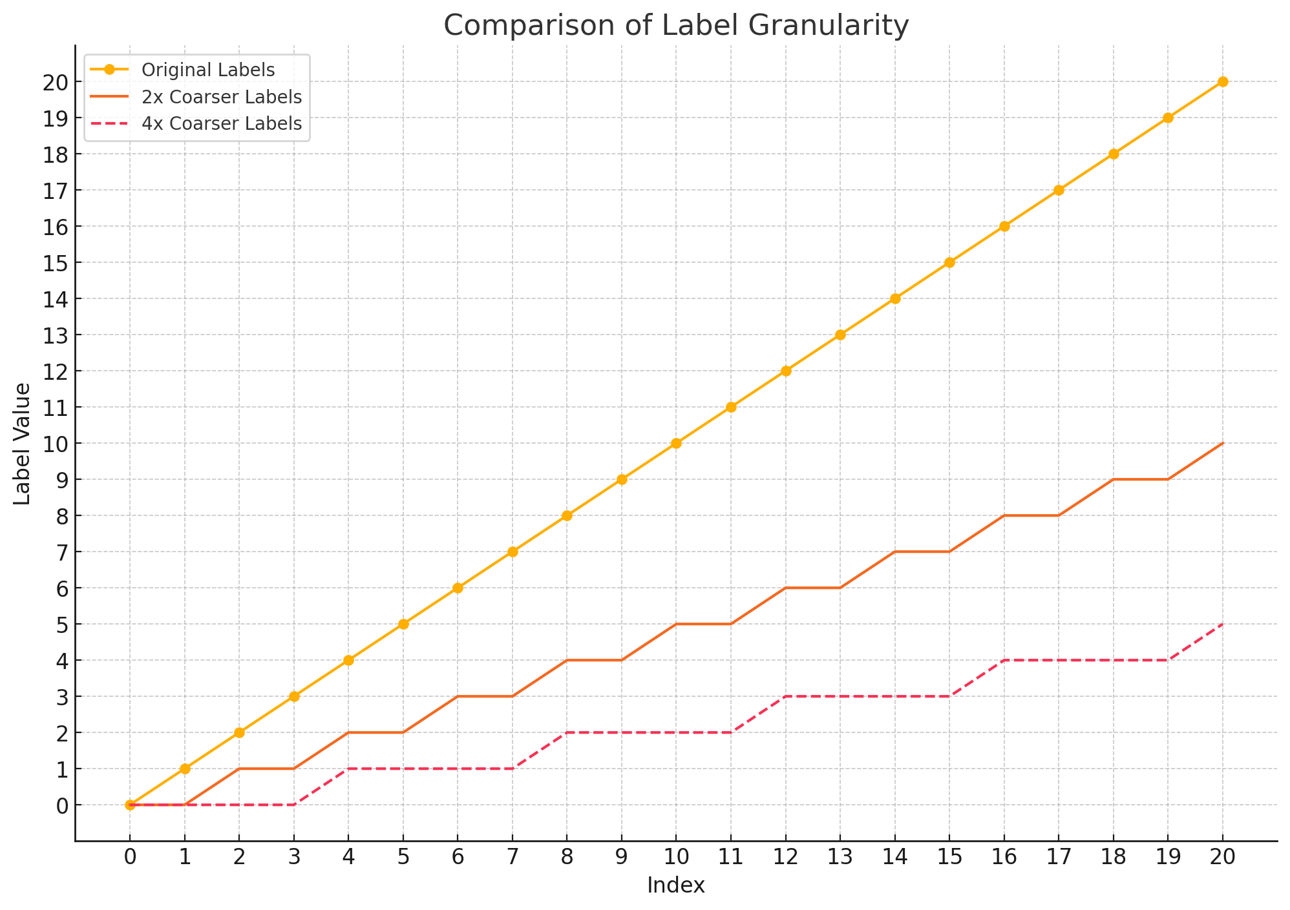
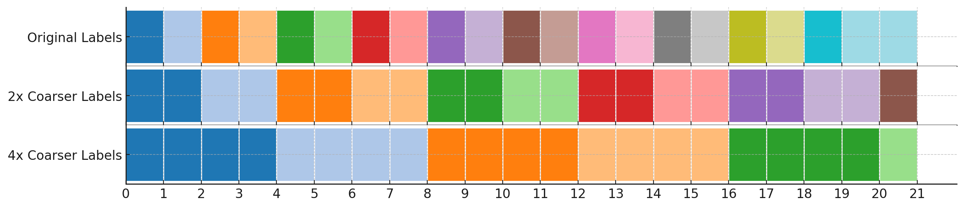
Multiple Granularity
How to change from high granularity to low granularity: merge!

Slide 17
Input and Output
Time-Series
Granularity
Information
Labels

Slide 18
Evaluation Metrics
Segmentation (often used in supervised)
Accuracy
MF1 (Macro F1)
Kappa
Clustering (often used in unsupervised)
ARI
NMI

Slide 19
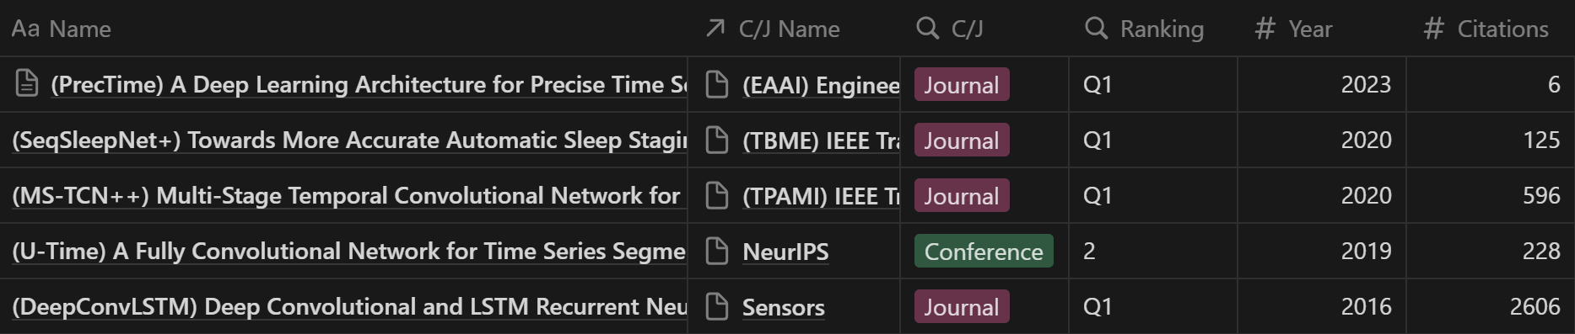
Baselines
Supervised

Slide 20
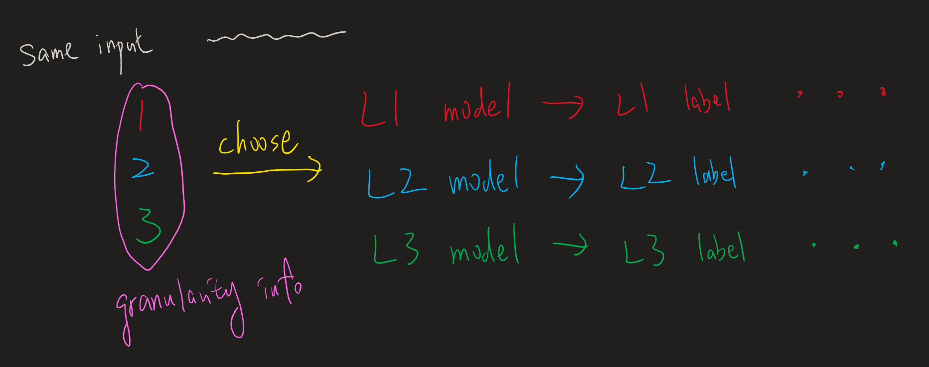
How to make baselines support multiple-granularity?

Slide 21
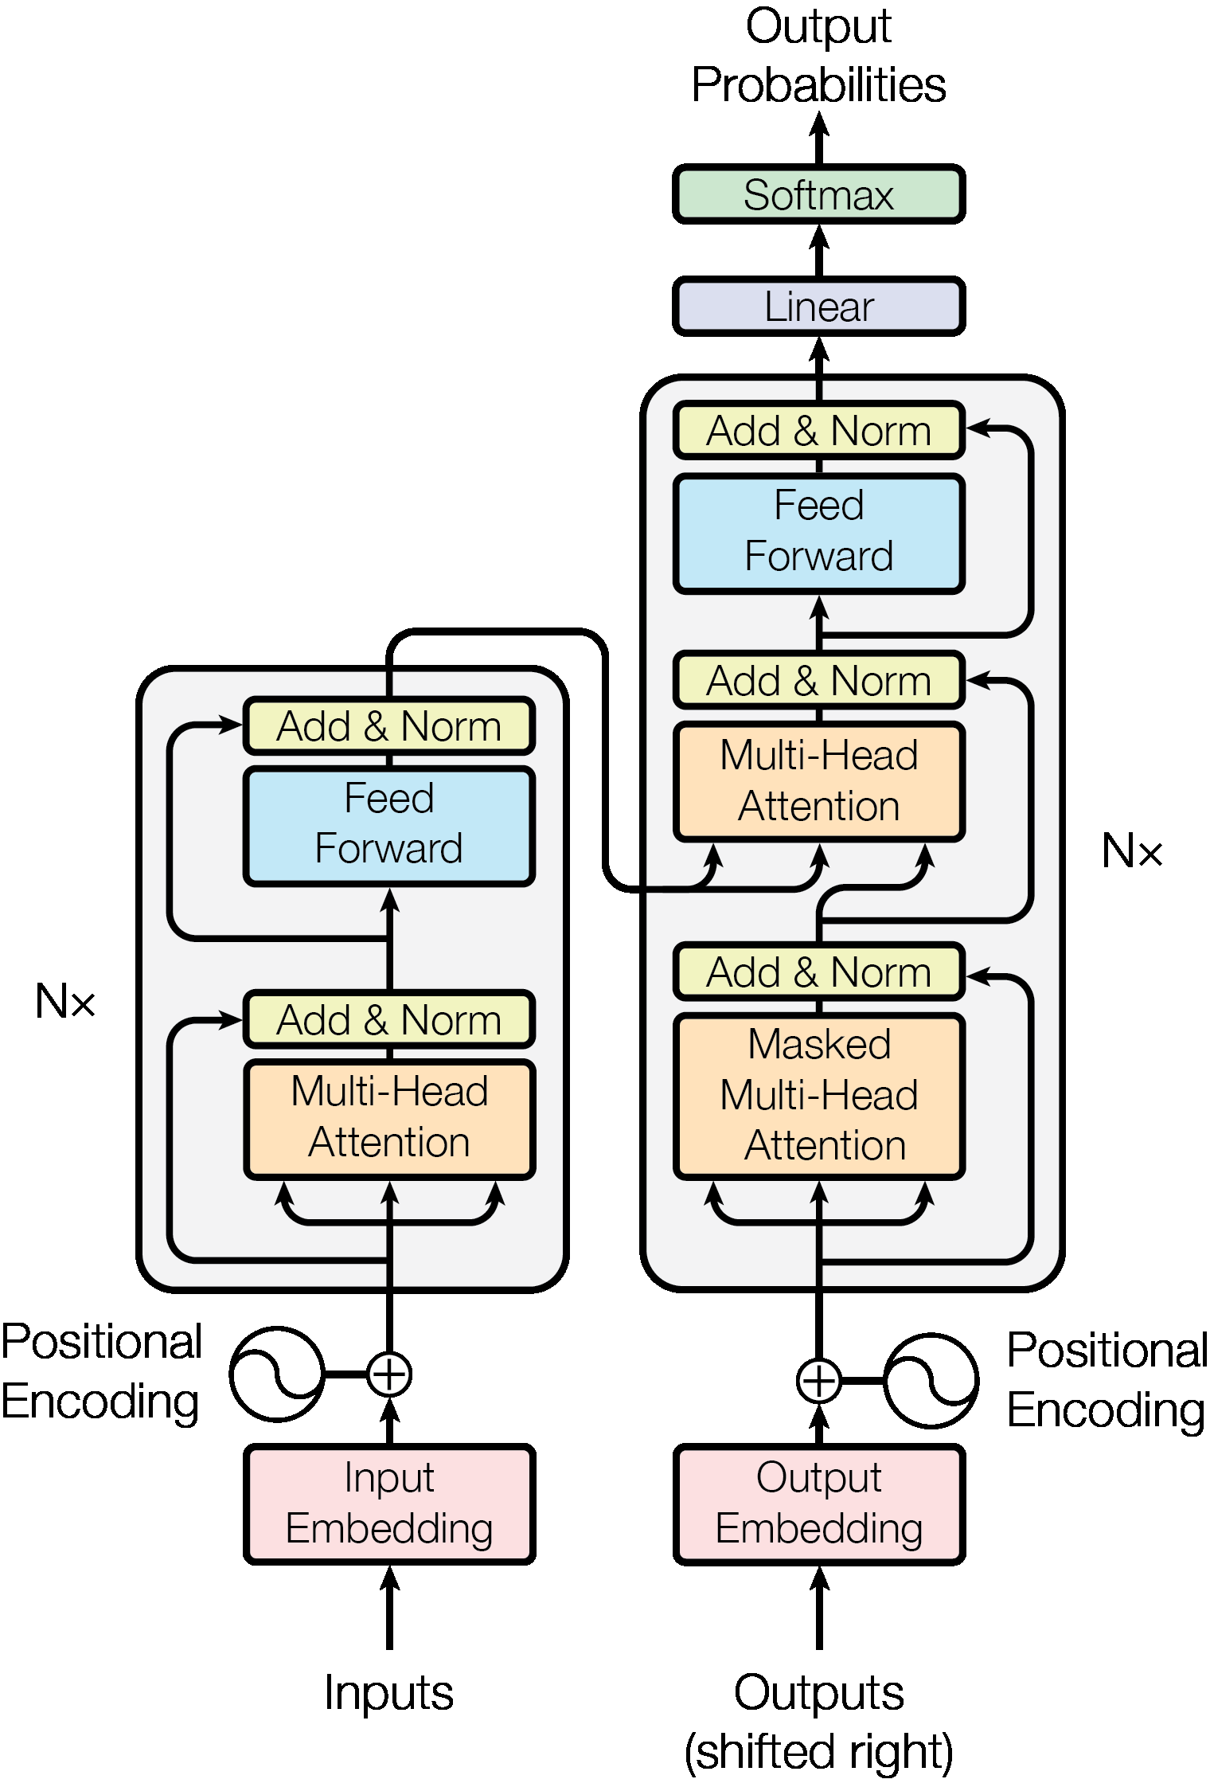
SAM v.s. PromptTSS
Segmentation
GPU
CPU
Final Mask
Image encoder
Mask decoder
Embedding
Prompt encoder
Multi-Head
Attention
Image
Prompt
Time-Series Input Layer
Prompt
Input Layer
Time-Series
Prompts

Slide 22
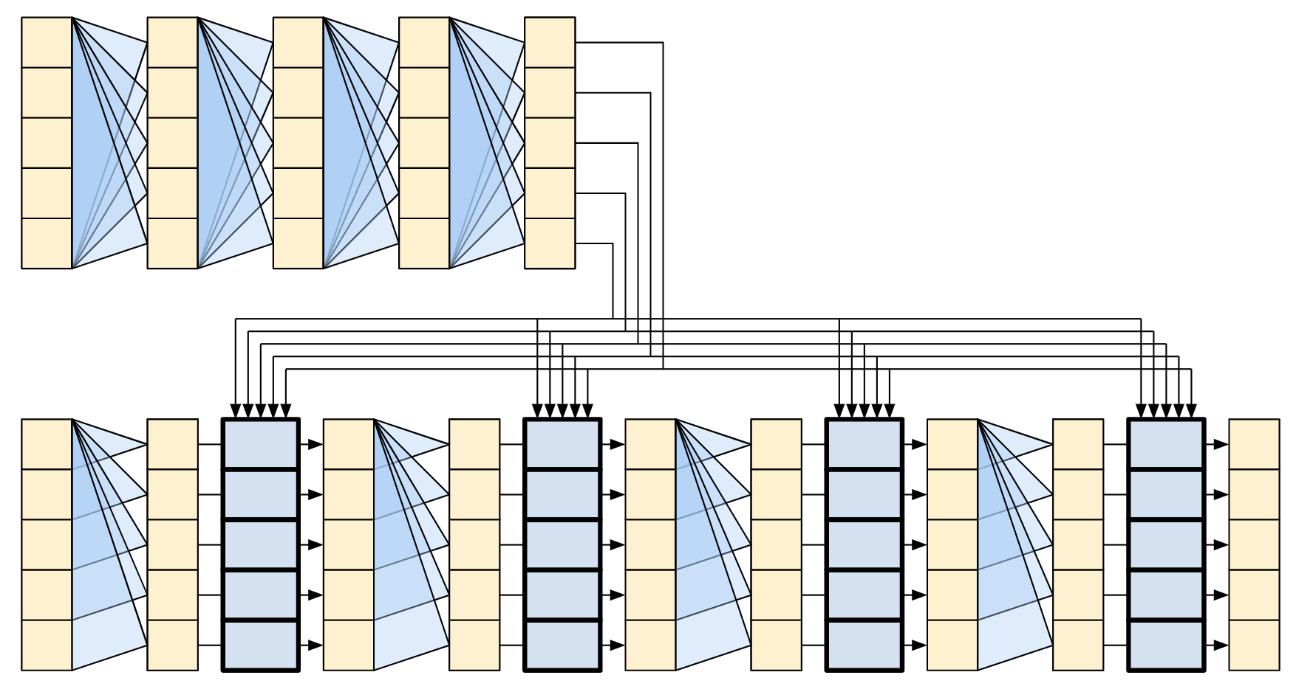
PromptTSS (w/o Patching)
Transformer
Encoder
Time-Series
(B, T_{in} , C)
(B, T_{in} , C)
(B, T_{in}, D)
(B, T_{in}, D)
Instance Normalization
(w/o affine)
Time-Series
Input Layer
(B, T_{in} )
(B, T_{in} , D)
Prompt
nn.Embedding(K, D)
Prompt
Input Layer
Transformer
Decoder
(B, T_{in} , D)
Output Layer
1. Dropout
2. Linear (B, T_{in}, K)
(B, T_{in}, K)

Slide 23
PromptTSS (w/ Patching)
Transformer
Encoder
Time-Series
(B, T_{in} , C)
(B, T_{in} , C_{t})
(B, T_{p}, C_{t}*P)
(B, T_{p}, D)
(B, T_{p}, D)
Instance Normalization
(w/o affine)
Patching
Time-Series
Input Layer
(B, T_{in} )
(B, T_{in} , C_{p})
(B, T_{p} , C_{p}*P)
(B, T_{p} , D)
Prompt
nn.Embedding(K, C_{p})
Patching
Prompt
Input Layer
Transformer
Decoder
(B, T_{p} , D)
Output Layer
1. Rearrange (B, T_{p}*D)
2. Dropout
3. Linear (B, T_{in}*K)
4. Rearrange (B, T_{in}, K)
(B, T_{in}, K)

Slide 24
PromptTSS (w/ Patching)
Transformer
Encoder
Time-Series
(B, T_{in} , C)
(B, T_{in} , C_{t})
(B, T_{p}, C_{t}*P)
(B, T_{p}, D)
(B, T_{p}, D)
Instance Normalization
(w/o affine)
Patching
Time-Series
Input Layer
Granularity level embedding
(B, T_{in} )
(B, T_{in} , C_{p})
(B, T_{p} , C_{p}*P)
(B, T_{p} , D)
Prompt
nn.Embedding(K, C_{p})
Patching
Prompt
Input Layer
Predicted
labels
Transformer
Decoder
(B, T_{p} , D)
Output Layer
1. Rearrange (B, T_{p}*D)
2. Dropout
3. Linear (B, T_{in}*K)
4. Rearrange (B, T_{in}, K)
(B, T_{in}, K)

Slide 25
Experiments
Please see the csv file

Slide 26
Thanks for your attention

